Slide 1

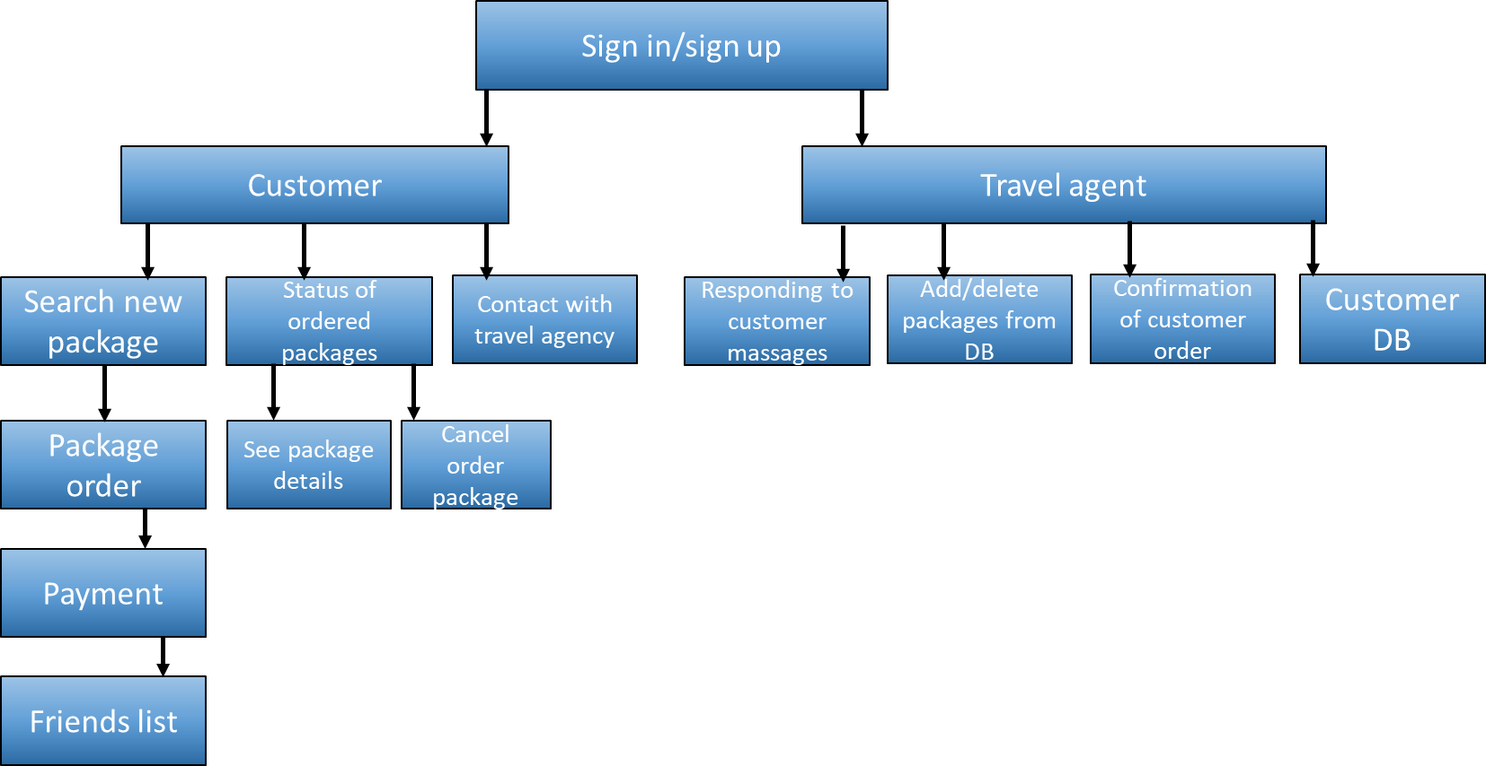
Travel agency
MADE FOR TRAVEL AGENCY IN ORDER TO IMPOVE DATA BASE AND INCREASE REVENUES BY USING A NEW ADVENCING OPPORTUNITIES TABLE SYSTEM

Slide 2

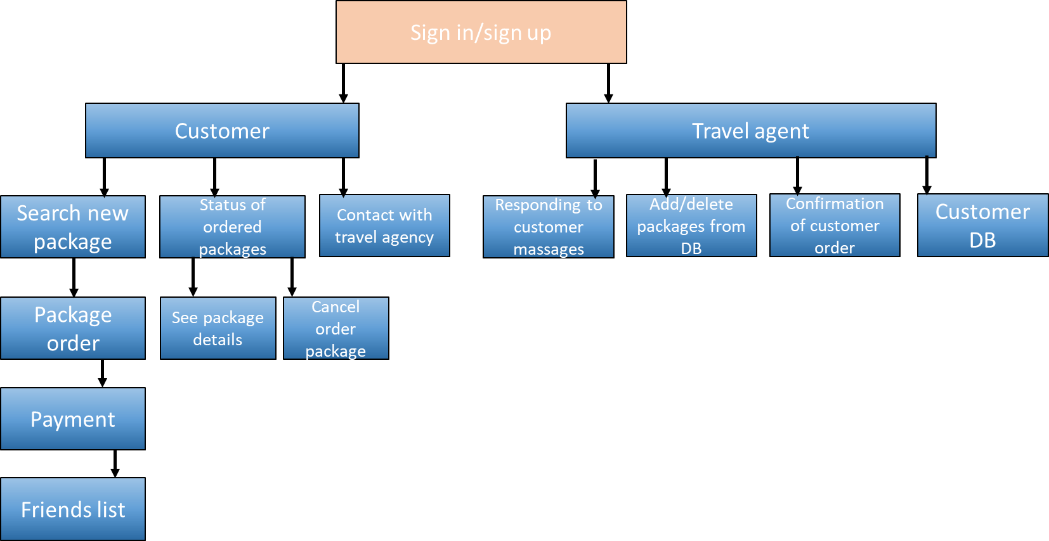
Log in/ sign up screen

Slide 3

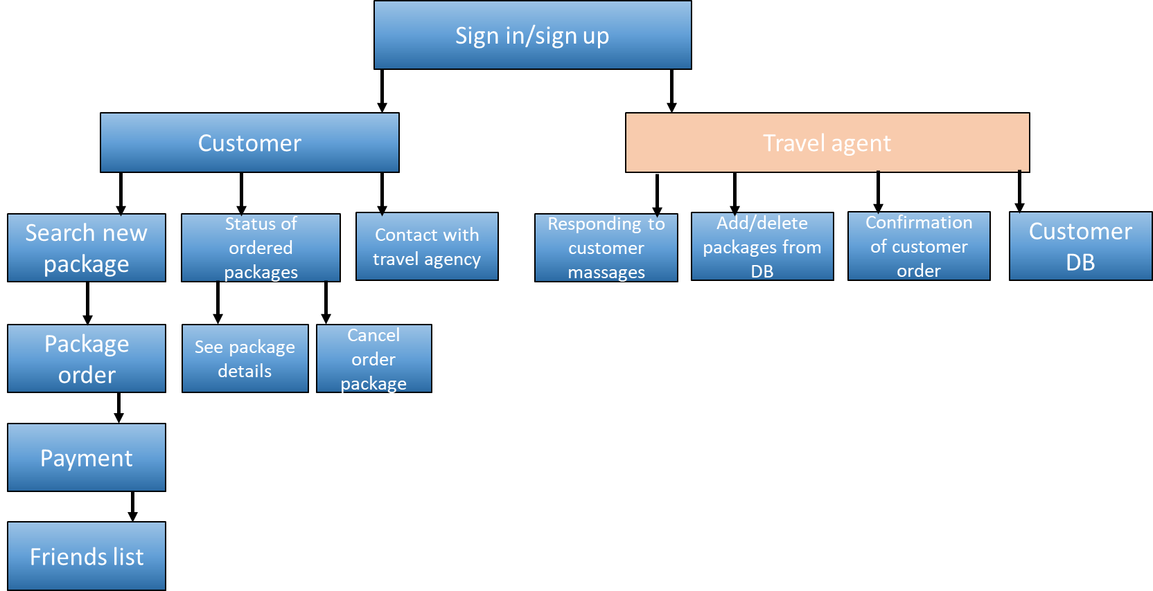
Agent 123
Confirmation of customer orders
Responding to customer calls
Add/ delete packages from DB
Home
Back

Slide 4
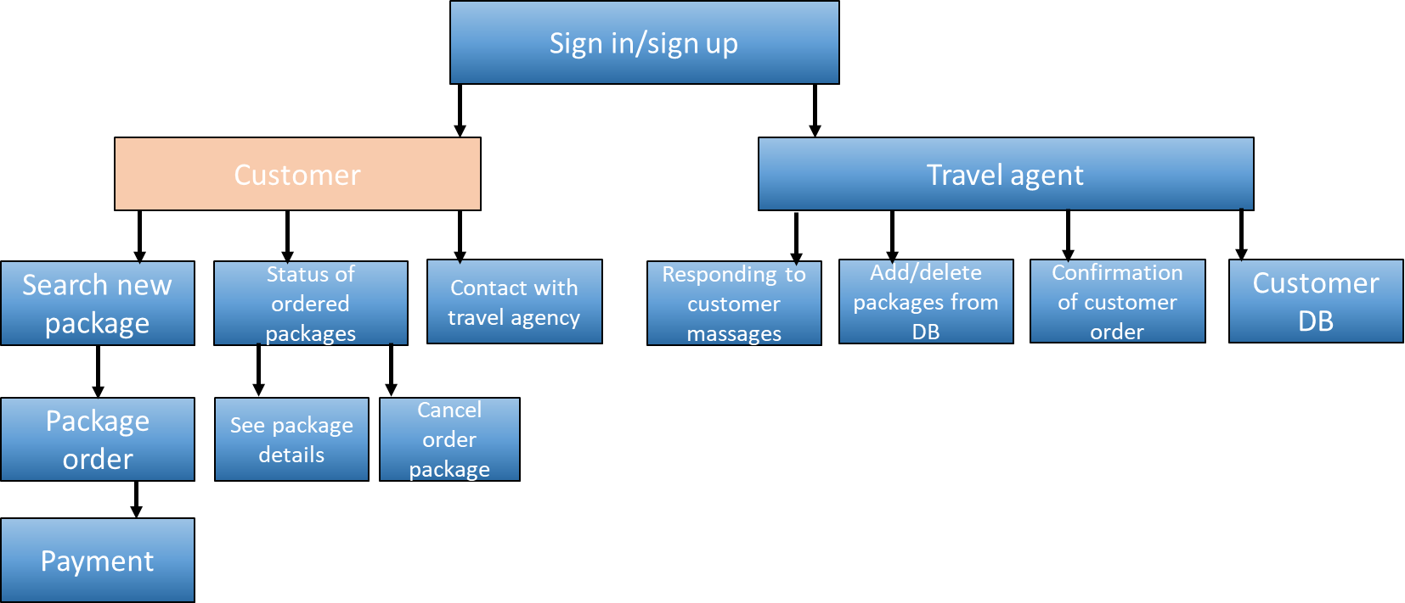
User 123
Search new package
Status of ordered packages
Contact with travel agency
Home
Back
Friends list

Slide 5

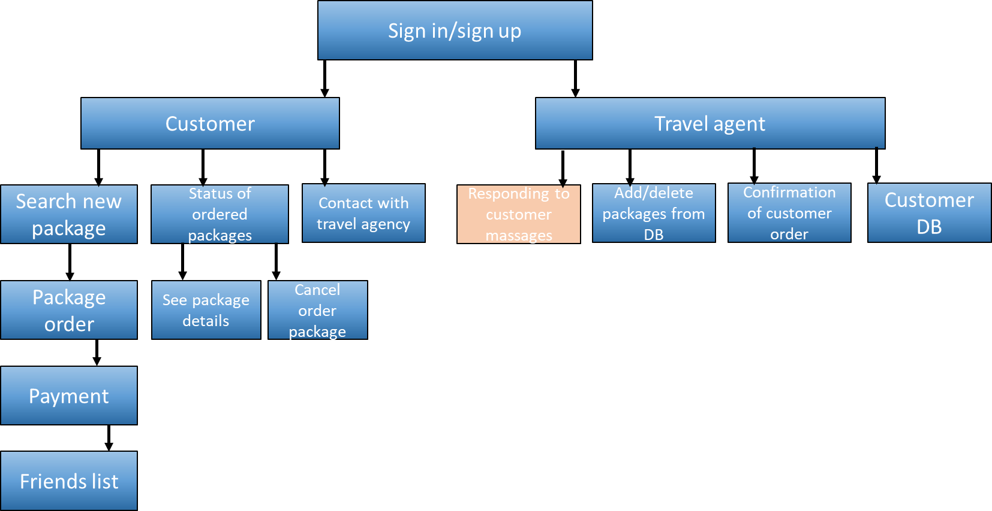
Pending messages
Taken care of
Home
Back

Slide 6

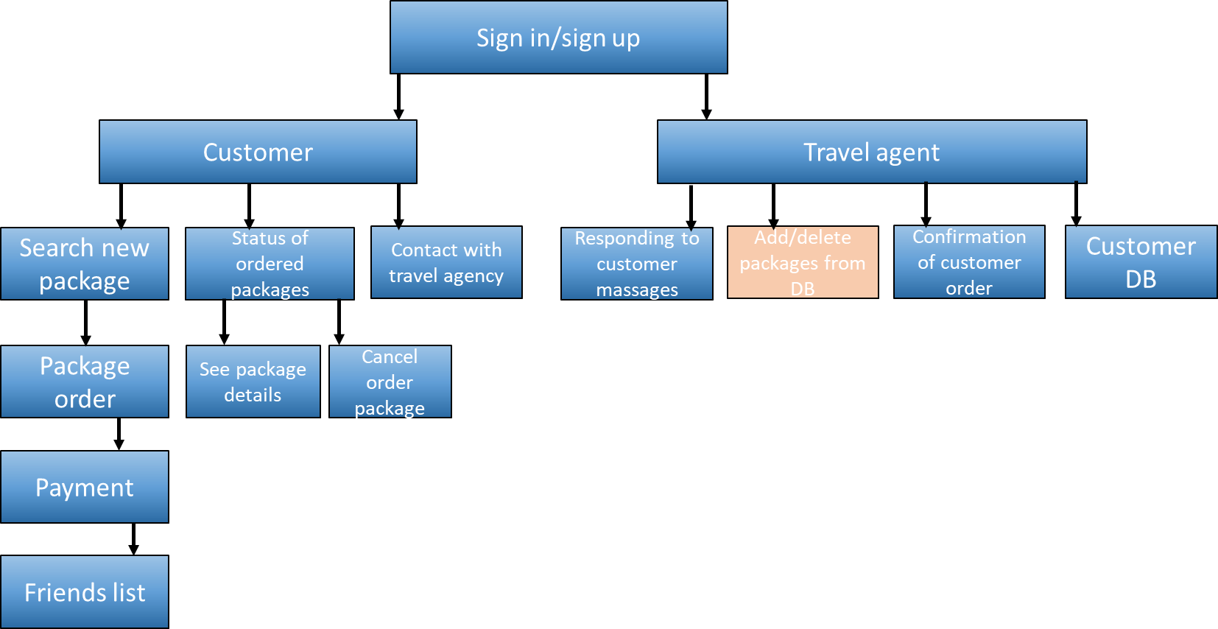
Add / delete packages from DB
quantity | price | flight number | flight company | hotel | return date | departure date | to | from
100 | 600$ | 222 | El Al | Fatal | 14/11/2021 | 01/11/2021 | Rio de jeneiro | Tel Aviv
77 | 370$ | 110 | El Al | Crown Plaza | 08/01/2021 | 02/01/2021 | Paris | Tel Aviv
150 | 250$ | 662 | Canada airlines | Hilton | 20/10/2021 | 10/02/2021 | Rome | Tel Aviv
 |  |  |  |  |  |  |  | +/ -
Delete package
Add package

Slide 7
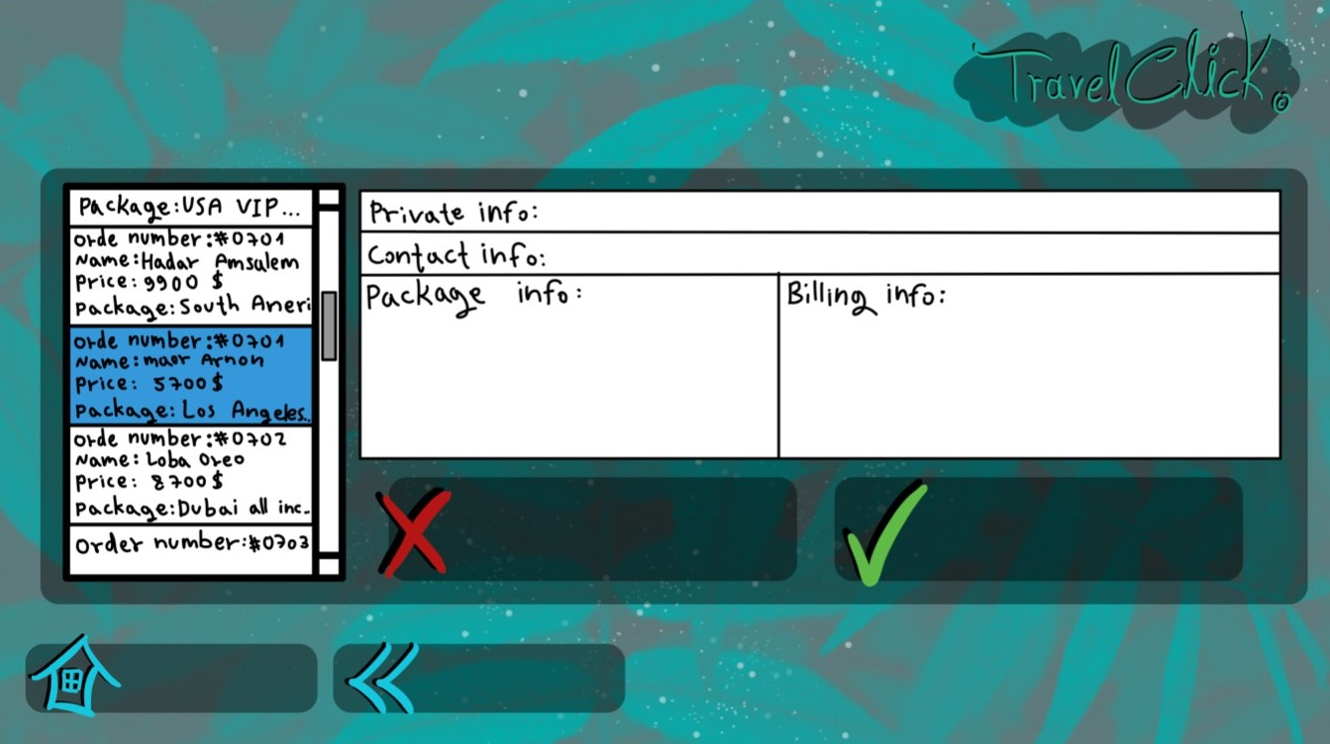
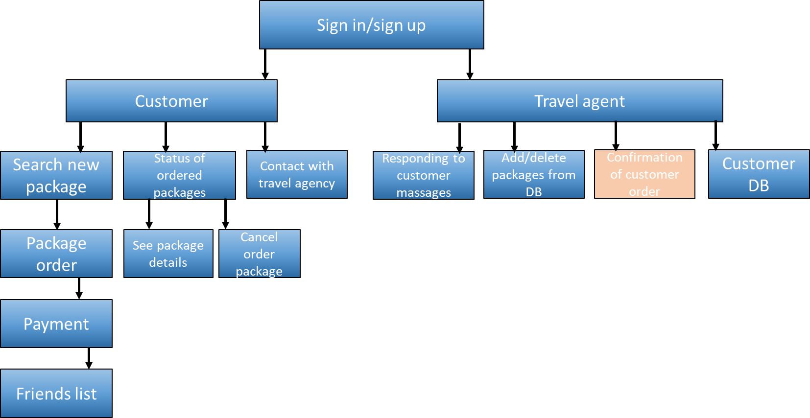
Travel orders
Decline
Approve
Home
Back

Slide 8

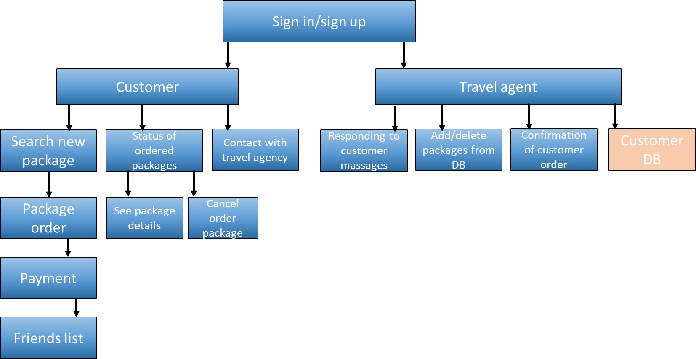
Customer DB
First name Last name Passport number Phone
Liubov Vasilchuk 5675678 0535768736
Home
Back

Slide 9

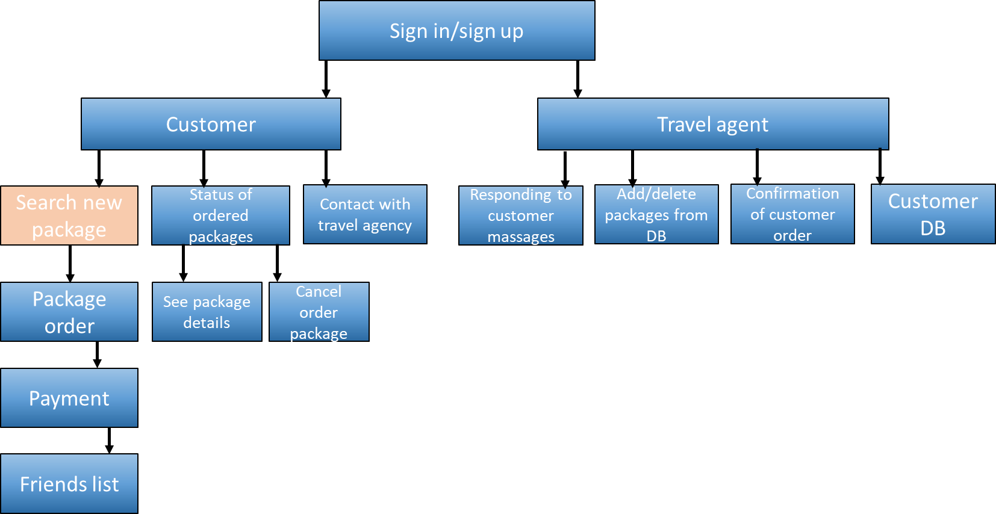
travelist
Find your dream vacation
from
to
departure
return
passengers
max price
hotel
Flight company
search

Slide 10

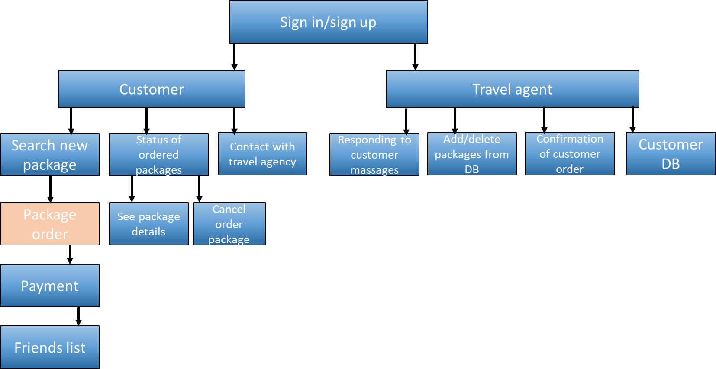
Departure date:10/11/21 Return date:24/11/21 To: Rome
Hotel: Crown plaza
Flight company: El Al Price:600$
Available :50 places
Click to order
Hotel: Hilton
Flight company: El Al Price:400$
Available :143 places
Hotel: Rimonim
Flight company: El Al Price:150$
Available :10 places

Slide 11

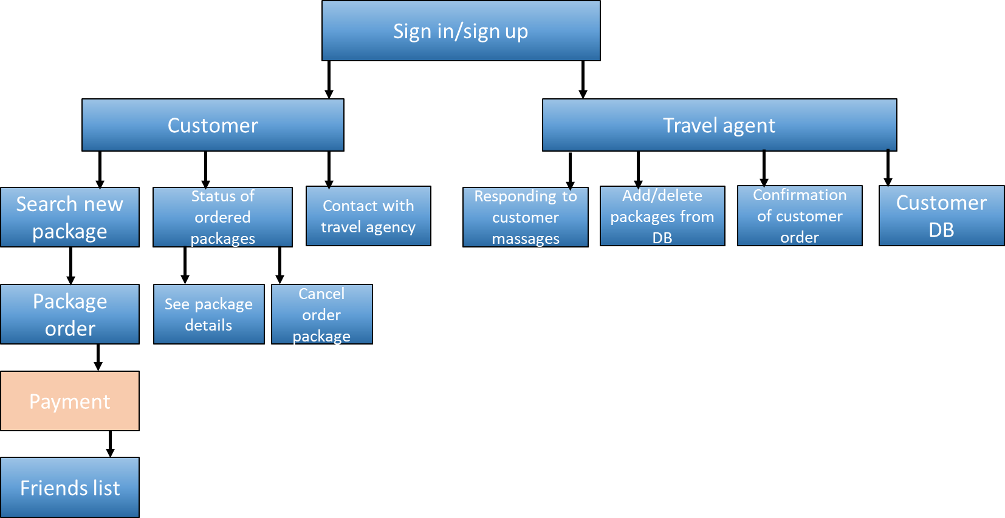
To: Rome
Hotel: Hilton
Flight company: El Al
First name: Moti
Last name: Shalom
Departure date: 10/11/21
Return date: 24/11/21
Passport number :023456
Select payment: visa/pay pal
Would you like to meet a friend ?
Home
Back
Order

Slide 12

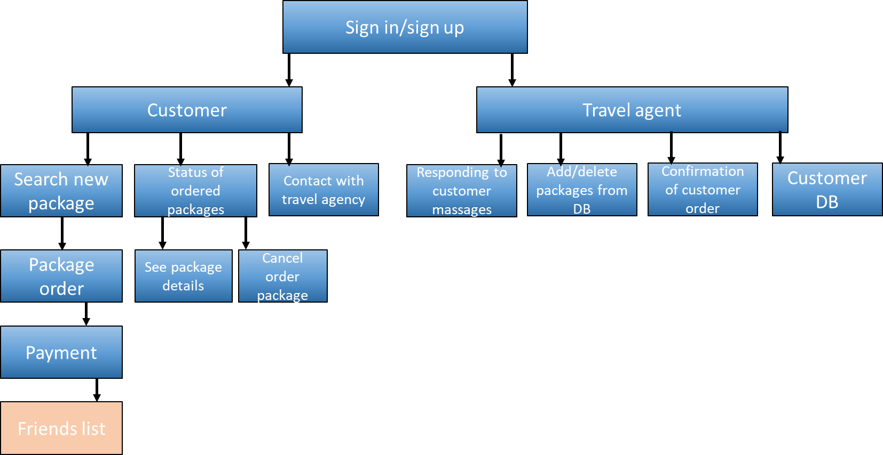
Maor Arnon, 25, maor@gmail.com, 0523578964
Matan Ben-Shushan, 26, matan@gmail.com, 0543543234
Home
Back

Slide 13
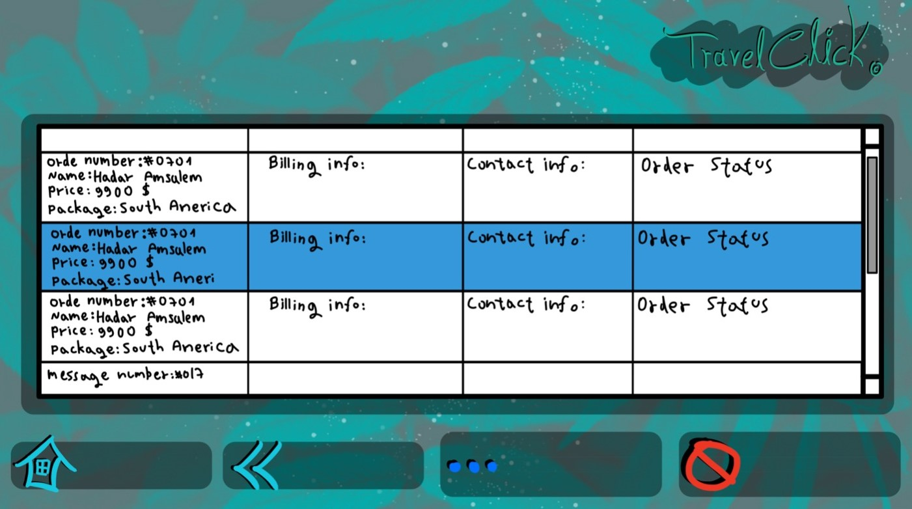
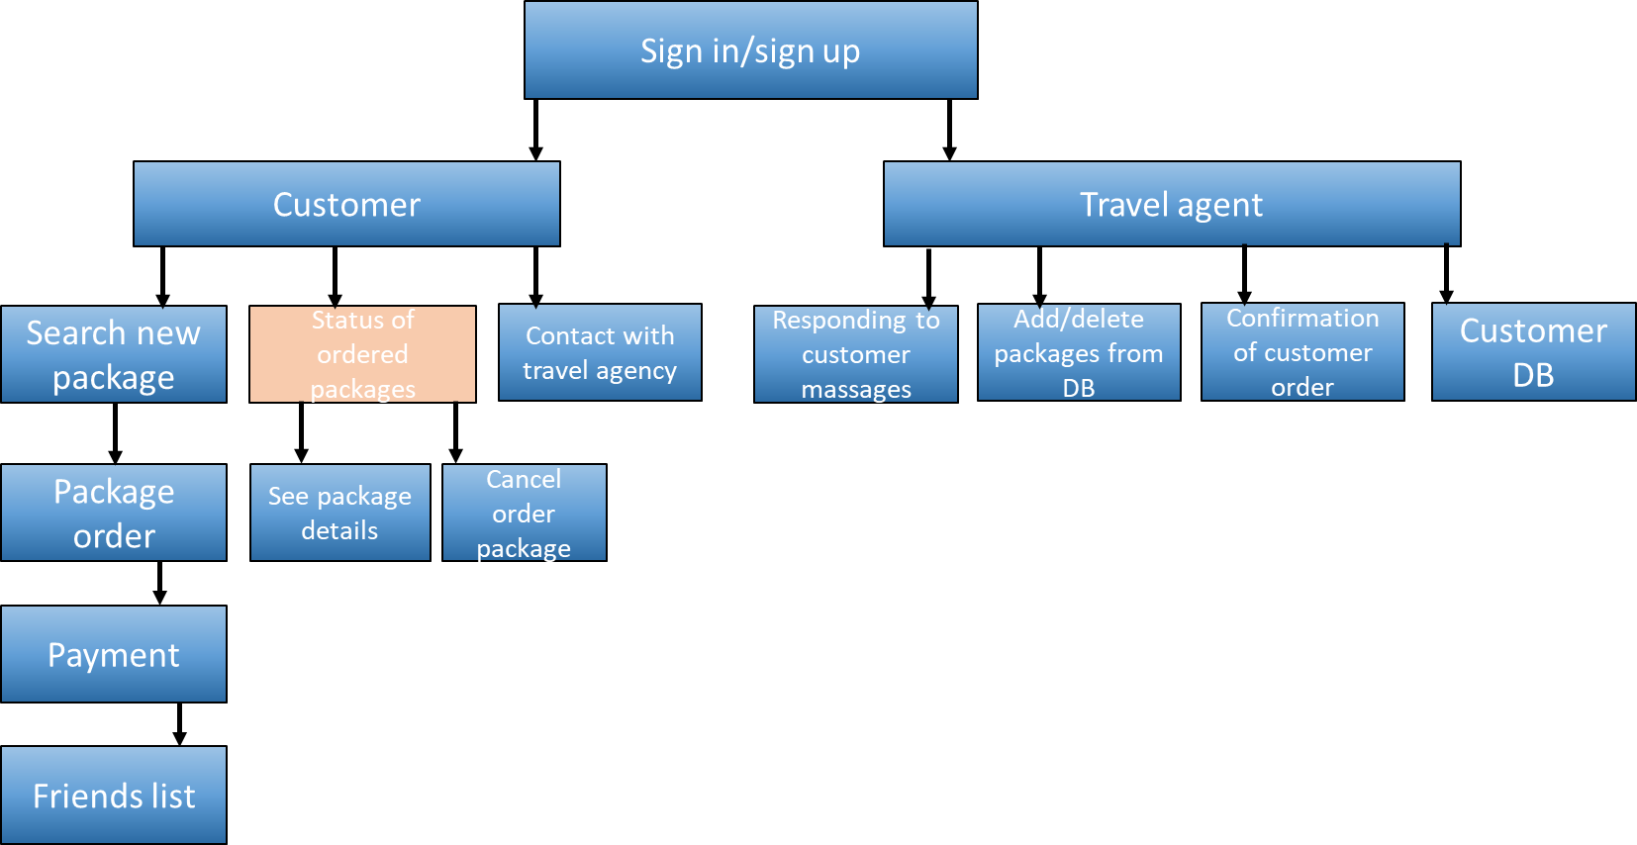
My orders:
Home
Back
More details
Cancel order

Slide 14

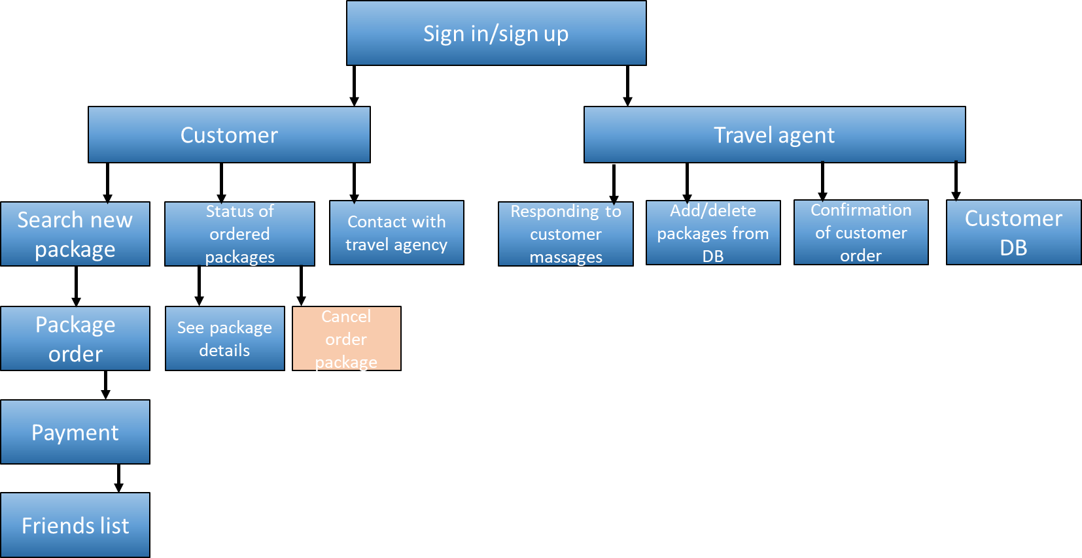
Are you sure you want to cancel your order ☹?
No, back to menu
Yes, cancel

Slide 15

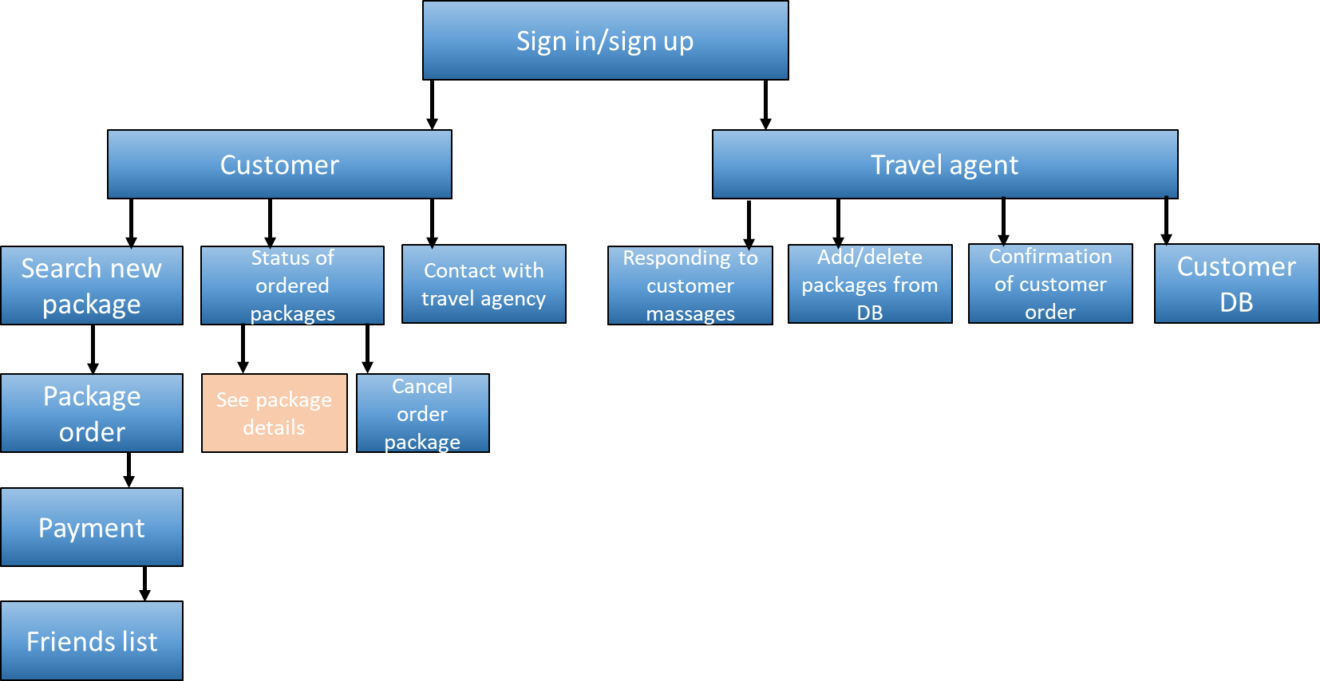
To: Rome
Hotel: Hilton
Flight company: El Al
First name: Moti
Last name: Shalom
Departure date: 10/11/21
Return date: 24/11/21
Passport number :023456
Select payment: visa/pay pal
Home
Back
Cancel

Slide 16

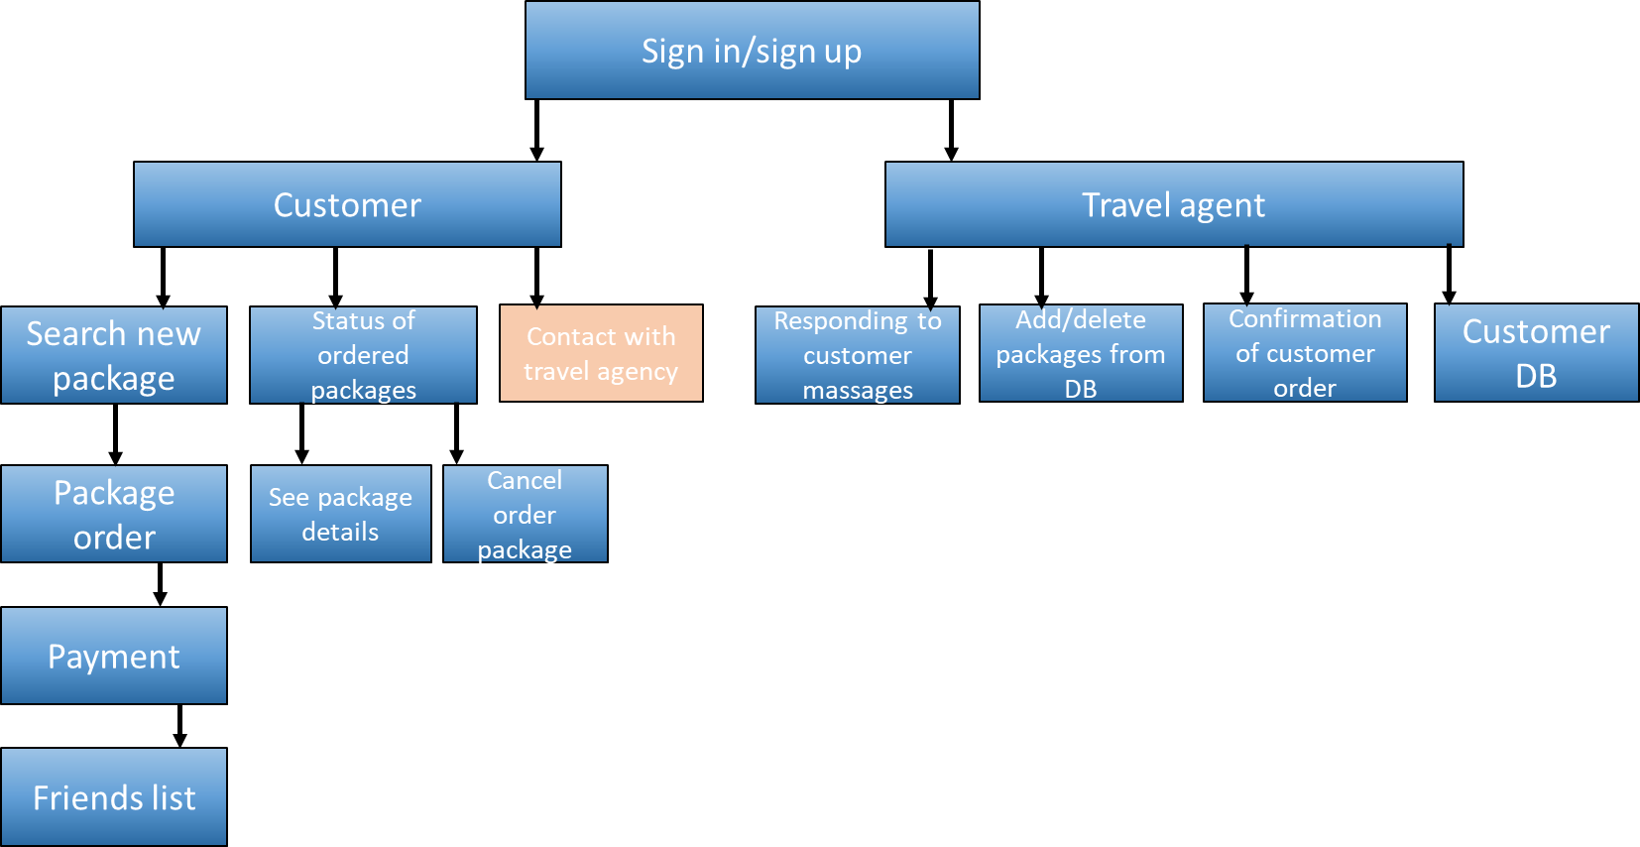
Contact us
E-mail: moshe@mail.com
Phone: +97250123456
Title: information
Hello what is the price for 12 people group?
Is there a discount?
Home
Back
Send

